Slide 1


Chapter. 1 Introduction to Psychology
Ms. Aisha Bano
aisha.bano@nu.edu.pk

Slide 2
Defining Psychology
The term Psychology is derived from two Greek words:
“Psyche” means mind/ soul
“Logos” means study
The scientific study of behavior and mental
processes is called Psychology (Feldman, 2019)
Behavior: any observable action or activity of living organism.
Mental processes: Internal subjective experiences (we infer from behavior)– e.g. sensations, perceptions, thoughts
2. Definition by American Psychological Association (APA,2012) from lecture

Slide 3
Schools of Thought in Psychology
(Historical background of Psychology)

Slide 4
Major Schools of Thought
Structuralism
Functionalism
Gestalt
Psychodynamic Model
Behaviorism
Humanistic Model
Cognitive Model

Slide 5
1. Structuralism: Wundt & Titchener
In 1879, Wilhelm Wundt established the first experimental laboratory at Leipzig, Germany.
known as Founder of Psychology
Also known as ‘Father of Scientific Psychology’
Subject matter of psychology is ‘the study of consciousness- the awareness of immediate experience’
Thus Psychology became the scientific study of Conscious Experience
Aim was to study ‘building blocks of the mind’

Slide 6
Structuralism
Structuralism was concerned with identifying the ‘units of conscious experience’
Wundt used the method of “Introspection” The term focuses on careful, systematic analysis of one’s own conscious experiences.
Looking into one’s self.
E.B.Titchener subdivided consciousness into physical sensations, feelings, and images

Slide 7
2. Functionalism
William James
John Dewey and William James were the chief exponents of this school of thought.
Based on the belief that Psychology should investigate the function or purpose of consciousness
Functionalism was concerned with ‘how does mind work or function?’
James argued that consciousness cannot be broken into elements.
He coined the phrase “stream of consciousness” means Continuous Flow of Thoughts

Slide 8
Functionalism
Functionalism was the study of the function, use and adaptability of the mind in changing environment

Slide 9
3. Gestalt
Wertheimer, Köhler & Koffka
Gestalt movement was concerned with the perception of “good form”.
Coined the phrase “whole is greater than the sum of its parts”
Psychology should study the whole pattern of behavior or experience.
This school of thought studies the role of mind and behavior as a whole.

Slide 10
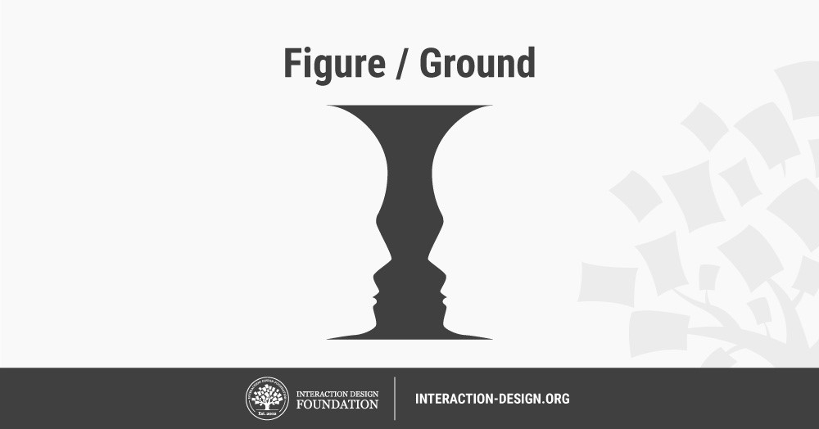
Commonly used figure/ ground image

Slide 11
4. Psychodynamic Model
Sigmund Freud
A famous physician and psychiatrist attempted to find the cause and cure of personality disorder
He is known as “Father of Modern Psychology”
Freud focused on the influence of the unconscious mind on behavior
Freud developed a method of therapy called psychoanalysis.
It’s an insight therapy that emphasizes the recovery of unconscious conflicts, motives, and defenses, through techniques such as Free association and Transference

Slide 12
Psychoanalysis
Freud was the 1st psychoanalyst; and the 1st to analyze ‘dreams.’
Psychoanalytic theory stressed the role of motives, drives, often hidden and repressed in the unconscious mind, which results in abnormal behavior.
He asserted that the sexual urges in the unconscious constitute the main human drive, known as the libido. It’s the energy created by life instinct (Eros).

Slide 13
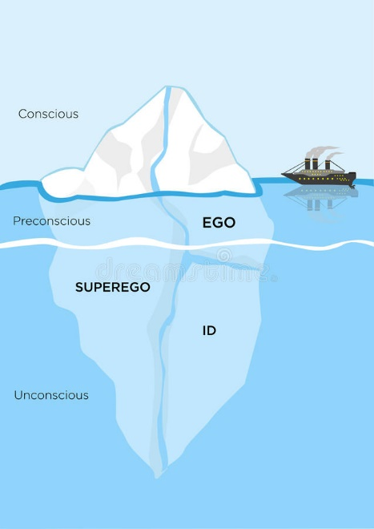
Structure of Mind by Sigmund Freud
Structure of Mind/ Levels of awareness
Conscious level
Sub-Conscious level
Unconscious level

Slide 14
Structure of Mind/ levels of Awareness
Conscious- things we are aware of e.g. our thoughts & perceptions.
Pre or Subconscious- things we can be aware of if we think of them.
Unconscious- deep hidden reservoir that holds the true “us”. All of our desires and fears.

Slide 15
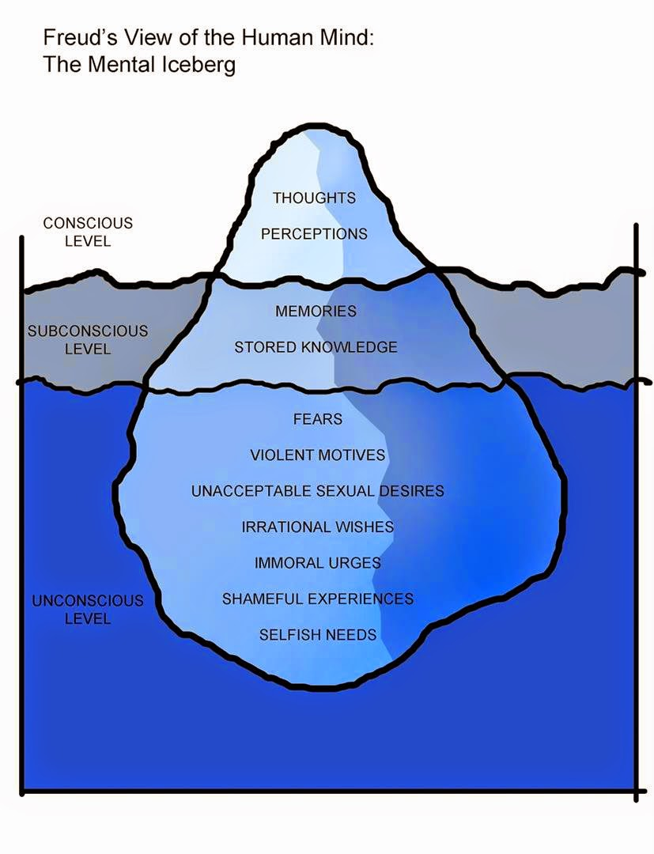

Slide 16
5. Behaviorism
Watson, Pavlov, Skinner
Behaviorism was founded by John B. Watson
It is only concerned with behavior that can be objective, observable and carefully measurable.
S--------------O-------------- R formula
Stimulus----Organism----Response
B.F. Skinner focused on the role of reinforcement.
Process of encouraging/strengthening some pattern of behavior is called reinforcement.

Slide 17
Behaviorism
Punishment (Decrease in behavior)
Reinforcement (increase in behavior)
Positive Reinforcement: Giving a raise in salary for good performance
Negative Reinforcement: Applying ointment to relieve an itchy rash leads to a higher future likelihood of applying the ointment.
Fine for late comers is also an example of N.R.
Positive punishment: Yelling at a teenager when she steals a bracelet.
Negative punishment: Restricting teenager’s access to car due to heavy traffic on roads.

Slide 18
6. Humanistic Approach
Carl Rogers, Abraham Maslow
Humanistic approach is concerned with helping people realize their full potential.
Carl Rogers and Abraham Maslow emphasized the unique qualities of humans, especially their free will (freedom of choice) and decision making, as well as their potential for personal growth.
This school of thought is concerned about Human abilities to control their lives.

Slide 19
7. Cognitive Psychology:
Jean Piaget, Noam Chomsky, Albert Ellis,
George Miller
Cognitive perspective focuses on how people think, understand, and know about the world.
Concerned with memory, thinking, language, learning, decision making.
Expanded the concept of “behavior” to include thoughts, feelings, and states of consciousness
Jean Piaget proposed ‘Theory of cognitive development’

Slide 20
Theory of cognitive development
Piaget's (1936) theory of cognitive development explains how a child constructs a mental model of the world. He disagreed with the idea that intelligence was a fixed trait, and regarded cognitive development as a process which occurs due to biological maturation and interaction with the environment.

Slide 21
Perspectives of Psychology
Biological
Psychoanalytic
Behavioral
Humanistic
Cognitive
Socio-cultural
Topic to be revised from book and lecture.

Slide 22
Application/ Fields/ Branches of Psychology
Developmental Psychology
Physiological Psychology
Experimental Psychology
Personality Psychology
Clinical Psychology
Counseling Psychology
Social Psychology

Slide 23
Fields of Psychology
Industrial and Organizational Psychology (I/O)
Health Psychology
Forensic Psychology
Military Psychology
Educational Psychology
Environmental Psychology
Cross-cultural Psychology
Note: See detail of all fields in bookish notes available in GCR

Slide 24
Developmental Psychology
This branch of psychology studies human mental and physical growth from conception to death. Also called Child Psychology.
• child psychologists
• adolescent psychologists
• life-span psychologists

Slide 25
Physiological (Biological) Psychology
Investigates the biological basis of human behavior. Focuses on the relationship between behavior and the physical system, including brain, nervous system, immune system and genetics.
• neuropsychologists
• psycho-biologists
• behavioral geneticists

Slide 26
Experimental Psychology
Conducts research on basic
psychological processes, such as:
learning
memory
sensation
perception
cognition
motivation
emotion

Slide 27
Social Psychology
Social psychology is the study of how people’s thoughts, feelings, and actions are affected by others.
Social psychologists study how people influence one another and how the role of society and its culture influence in the development of one’s personality.

Slide 28
Personality Psychology
One of the largest and most popular branches of psychology, focuses on the consistency in people’s behavior over time and the traits that differentiate one person from another.
Personality psychologists study the differences among individuals.
They strive to understand how personality develops and influences the way we think and behave.

Slide 29
Clinical & Counseling Psychology
Clinical psychology deals primarily with the diagnosis, cause, and treatment of psychological disorders such as depression, eating disorders, and chronic substance abuse.
Counseling psychology focuses primarily on educational, social and career adjustment problems, e.g. counseling psychologists work with students, advising them about personal problems and career planning.

Slide 30
Industrial & Organizational Psychology
Industrial/organizational psychology is concerned with the psychology of the workplace.
I/O psychologists are interested in
selecting and training personnel
improving productivity and working conditions
the impact of computerization and automation on workers

Slide 31
Health Psychology
Health Psychology explores the relationship between psychological factors and physical ailments or disease.
This branch observes how
Behavior
Biology &
Social context
Influence illness and health.

Slide 32
Forensic Psychology
Forensic psychology focuses on legal issues, such as determining the accuracy of witness memories.
This branch involves applying psychology to
Law
Criminal investigation
Within criminal justice system

Slide 33
Educational Psychology
Educational psychology is concerned with solution of various psychological problems of educational institutions.
The primary concern of educational psychologists is to deal with:
Schools
Students’ concerns
Educational issues
Teaching psychology
Parents and teachers connection

Slide 34
Environmental Psychology
A multidisciplinary field that investigates the effects of the physical environment on human behavior and welfare. Influences studied may include environmental stressors (e.g., noise, crowding, air pollution, temperature); design variables (e.g., lighting); the design of technology ; and larger, more ambient qualities of the physical environment, such as floorplan layouts, the size and location of buildings, and proximity to nature (APA).

Slide 35
Cross-Cultural Psychology
The branch of psychology known as cross-cultural psychology has recently emerged. Basically, it studies human behaviors from the point of view of culture.
By comparing and contrasting cultures, it analyzes an individual from a cultural perspective.
It has been influenced by anthropology and emphasizes social psychological analyses of international differences

Slide 36
Research Methods
Research Methods are scientific in nature and scientific investigations are systematic. These investigations follow an orderly pattern with the following steps:
Formulate a testable Hypothesis
Design the Study
Collect the Data
Analyze the data & draw conclusion
Report the finding
(Example: Final Year Projects in the final year of your degree program follow above mentioned steps)

Slide 37
Research Methods
The research methods in Psychology are as follows:
1. Case history
In-depth study of an individual
2. Naturalistic observation (Field study method)
3. Survey Method
Introduction to topic, questionnaire, statistical analysis, discussion, result/ conclusion
4. Experimental Method
To establish meaningful relationship between Stimulus & Response
5. Correlation
(statistical measure of relationship)

